Slide 1
My Bookprint

Slide 2
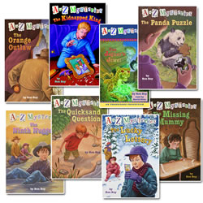
The A To Z Mysteries
Ron Roy
1st -2nd Grade

Slide 3
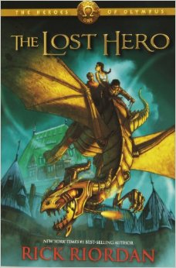
The Lost Hero
Rick Riordan
4th Grade

Slide 4
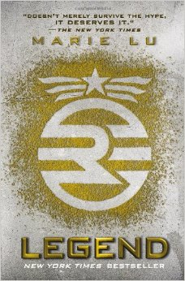
Legend
Marie Lu
7th Grade

