Slide 1
Black-Out Poetry

Slide 2
What is Poetry?
Poetry is literary work in which special intensity is given to the expression of feelings and ideas by the use of distinctive style and rhythm.

Slide 3
Types of Poetry
What are some types of poetry that you’re familiar with?
Acrostic
Couplet
Free verse
Haiku
Found poem
Limerick
Many, many more.

Slide 4
Why do we read and write poetry?
Dead Poets Society Clip

Slide 5
Writing Poetry is Nothing to Fear
Often people are fearful of writing poetry because they feel it’s too difficult.
The reality is that we are surrounded by it all the time. The music we listen to contains all of the poetic devices we’ve discussed, including symbolism, imagery, rhythm, rhyme, etc.
In order to alleviate the stress that comes with writing poetry, we are going to use a method that is gaining popularity among the writing community.

Slide 6
Black-Out Poetry
Black
out
poetry

Slide 7
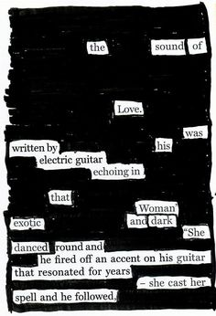
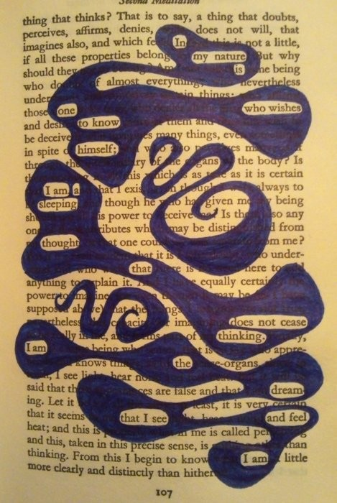

Slide 9
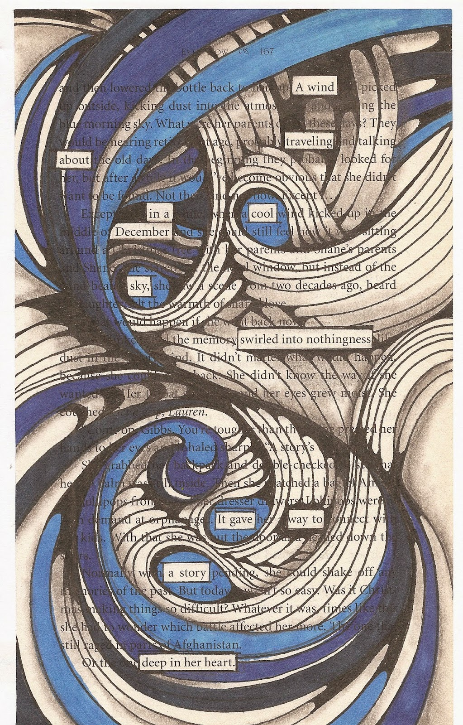
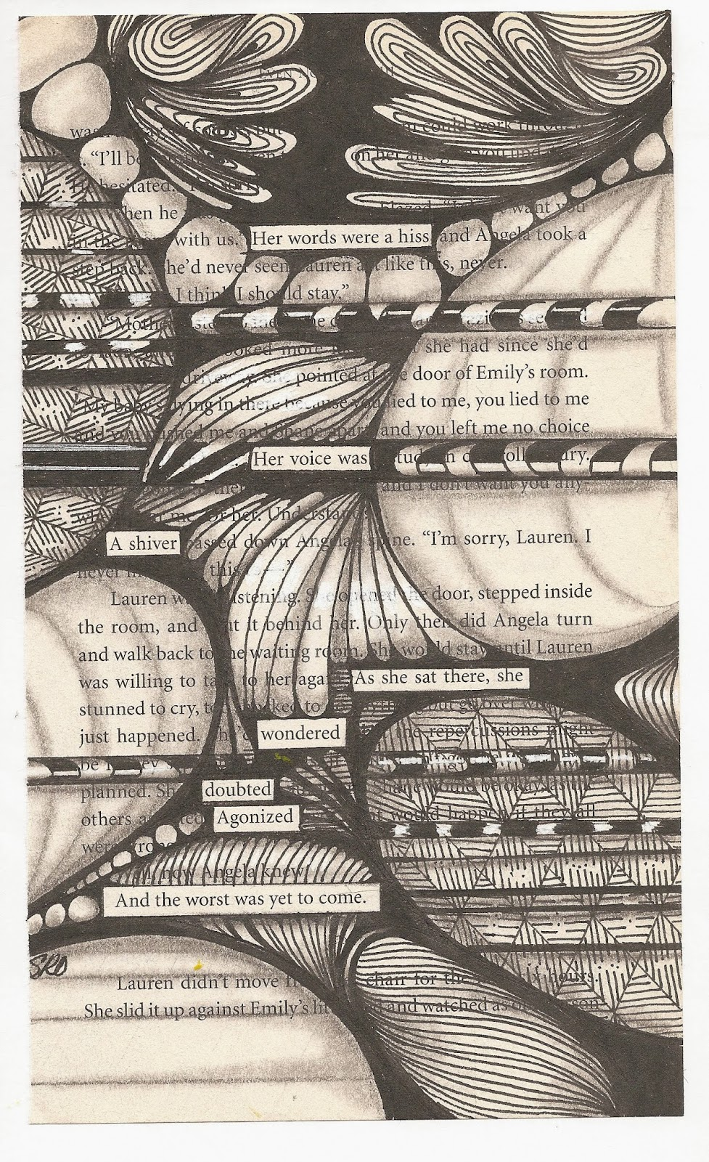

Slide 10
What is “Black-Out Poetry”?
“Blackout poetry” is poetry made by redacting the words in a text with a permanent marker, leaving behind only a few choice words to make a poem.

Slide 11
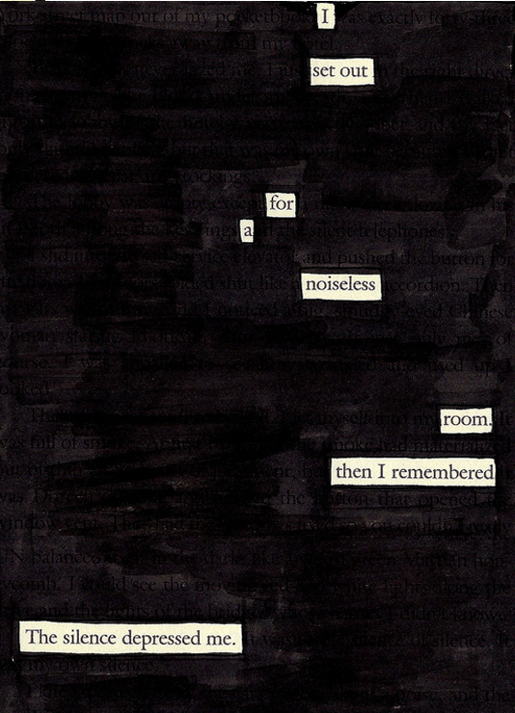
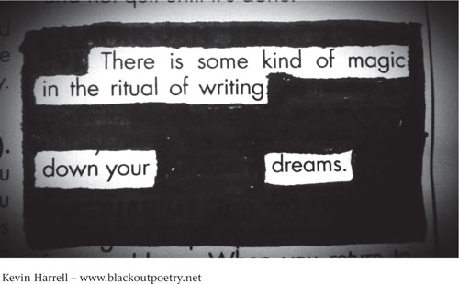

Slide 12
Black-Out Poetry
How to create your own Black-Out Poem.
Get a piece of work with at least some words that may seem useful.
Begin by underlining some words you plan to use (in pencil).
Circle words you KNOW you’d like to use (in marker).
Black out everything else with your marker.
Don’t black out things you might want to use, yet.

Slide 13
Black-Out Poetry
Now it’s your turn!
We’ve chosen parts from Edgar Allen Poe’s short stories.
So you can make it as creative and creepy as possible!

