Slide 1
Irony in Literature
Students Will Be Able To:
Identify irony in literature (and film), identifying and differentiating between the three main types of irony (verbal, dramatic, and situational).
Analyze a plotline in relationship to the author’s use of irony.
Evaluate the effectiveness of the author’s use of irony in any given text.

Slide 2
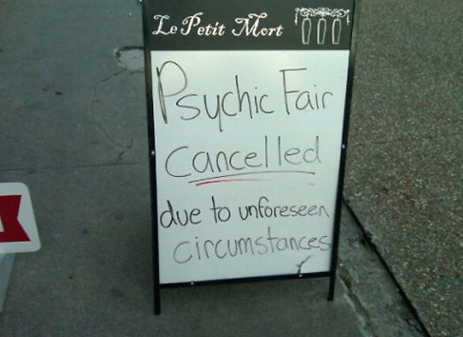
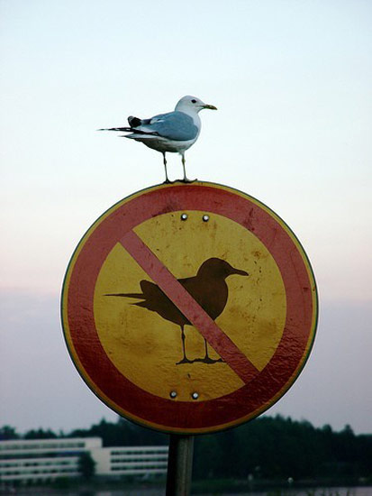
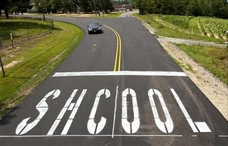
We are surrounded by irony.
Mean Girls clip
You already use it, hear, think about, or see it on a daily basis….

Slide 3
General Definition of Irony
Irony is an expression of meaning using language that normally signifies the opposite; often used for humorous or sarcastic effect. In a nutshell, irony is the difference between appearance and reality.
It comes in 3 forms.

Slide 4
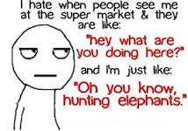
Verbal Irony
TED-Ed Verbal Irony Lesson (3.5 min.)
What is said is the opposite of what is meant (focus is on language).
Often synonymous with sarcasm
Verbal irony is not always sarcastic, as it does not necessarily have a negative attitude (which sarcasm always involves).

Slide 5
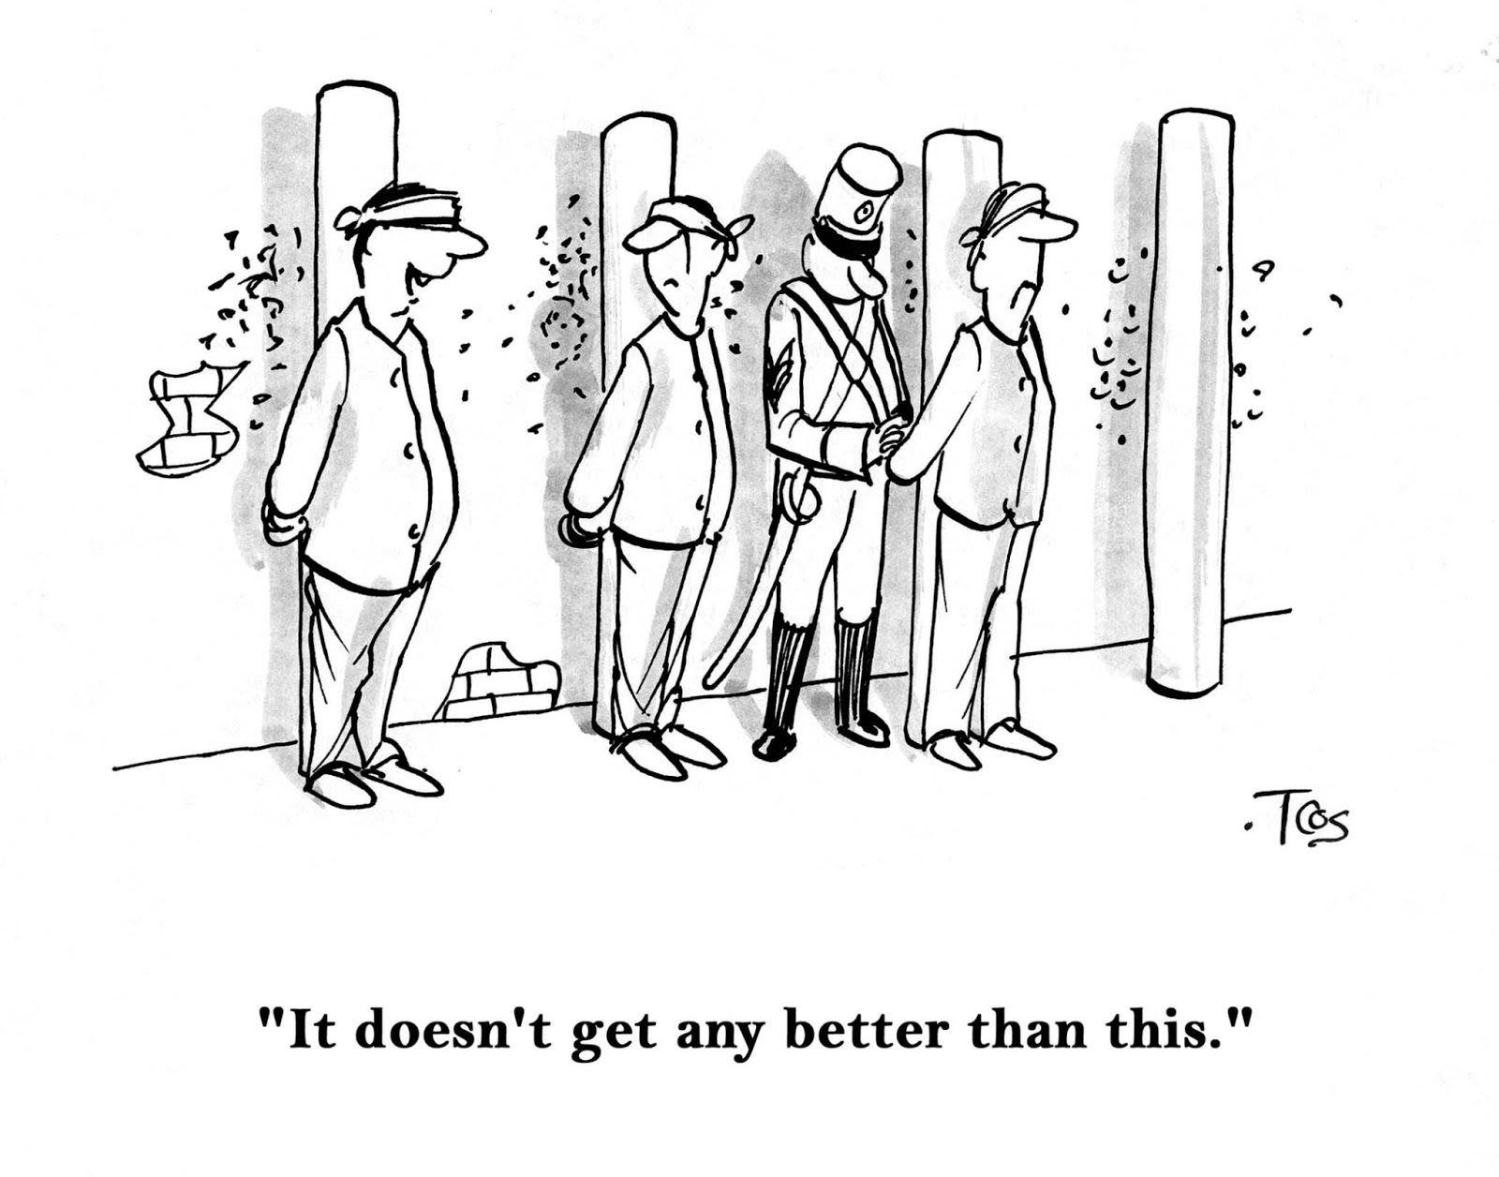
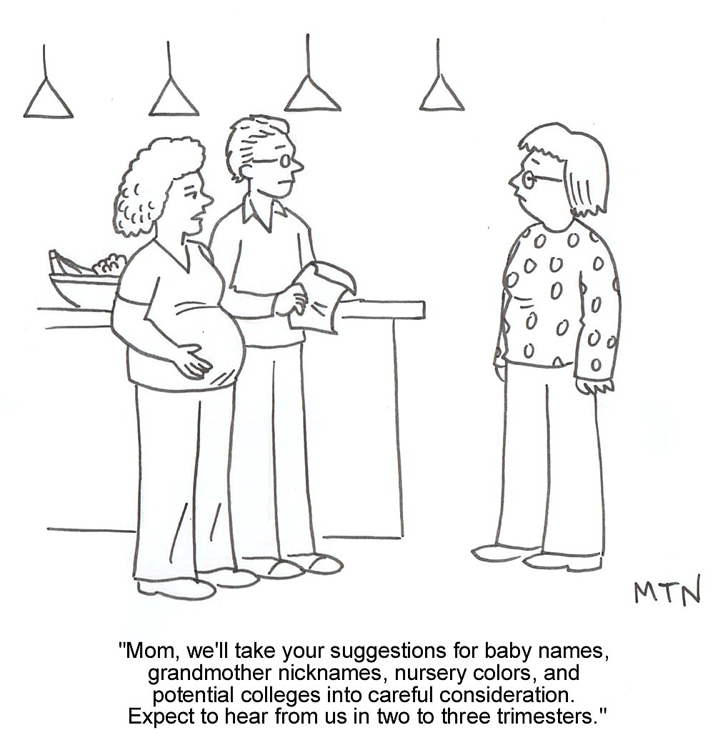
Analyzing Examples
Discuss with a partner or team of 3 each of the images to the left. Address the following and be prepared to share your conclusions as a class .
Are these examples of verbal irony? Why/not?
IF verbal irony, what do the words mean at face value (words only)?
IF irony, what is the actual intention of the statement? How can you tell?

Slide 6
Yes! Both are Examples of Verbal Irony…
While the words imply that the couple will happily receive suggestions, the meaning is that they will take those suggestions only after the baby is born; the meaning effectively is that the couple want nothing to do with the input of the soon-to-be-grandmother.
The words imply nothing could be better than what is happening; being lined up and tied for certain execution implies there could be nothing worse, however.

Slide 7
Situational Irony
Review TED-Ed lesson clip (3 min.)
What occurs is the opposite of what was expected to occur in a storyline (plot).
Is this image an example of situational irony? How/not?
View & discuss the following clip: what is the situational irony here? In other words, what does the audience expect? What actually happens?
Star Wars Clip

Slide 8
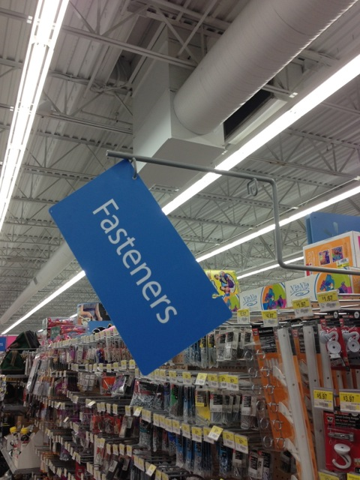
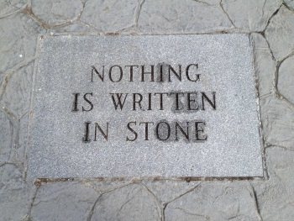
How or why are these images examples of situational irony? Working with those around you, discuss/explain each.

Slide 9
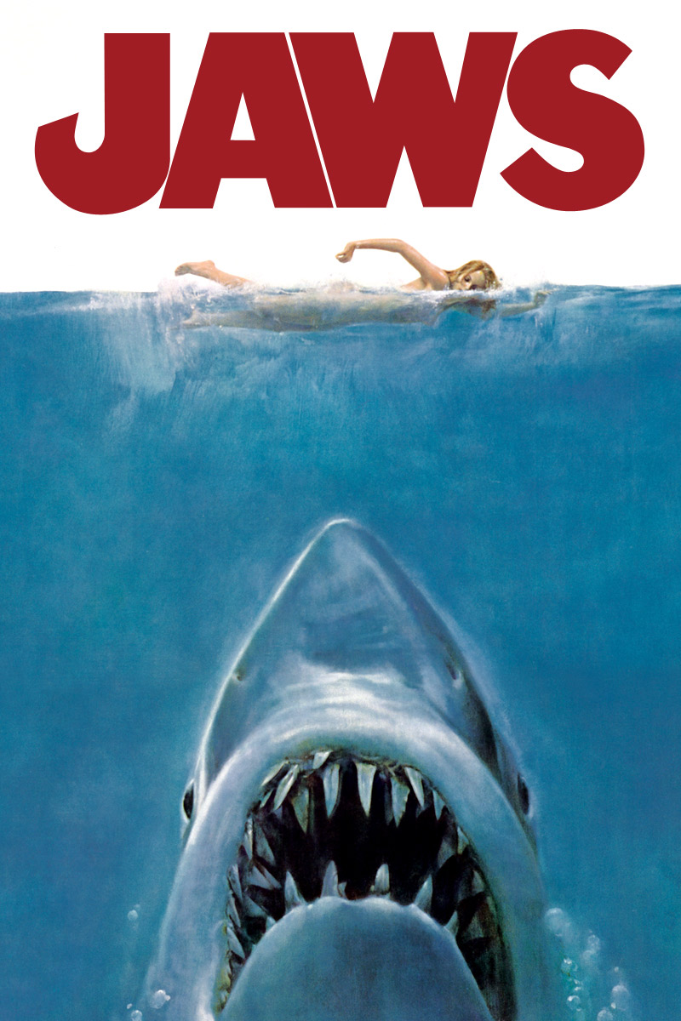
Dramatic Irony
Review brief TED-Ed lesson clip (3 min.)
The audience knows something that the characters do not yet know or realize; we are in on a secret with the author.
Characters’ words and actions take on a unique meaning for the audience in comparison with the other characters, heightening the suspense and audience tension.

Slide 10
How or why are these examples of dramatic irony? Whole group discuss
What is happening in the image to the right?
How is this dramatic irony?
What do we know that the character doesn’t?
Why/how does this clip demonstrate dramatic irony?
Frozen – Party’s Over

Slide 11
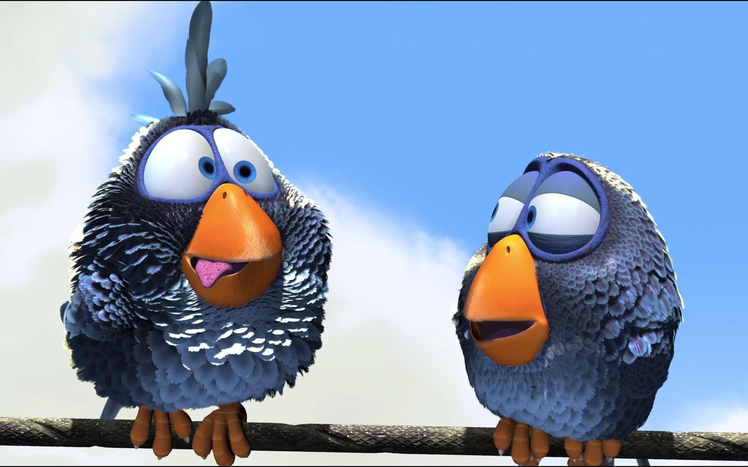
Formative Assessment: What Type(s) of Irony Am I?
View the Pixar short film, ”For The Birds”.
After viewing, share with a neighbor your thoughts on the potential irony(ies) of this film, and listen to the ideas of your peer.
Prepare to share/discuss as a whole group.
Whole Group Discussion:
Any verbal irony?
Situational irony? Yes = all the little birds apparently want to be alone yet they all end up sitting together on the same wire; also, the big bird wants company but ends up being alienated and isolated; finally, the situational irony includes the little birds trying to dump off the big bird from the wire, sending him down, but in actuality they end up heading in the opposing direction with great force, disturbing their own peace and comfort rather than restoring it (which was their goal!).
Dramatic irony? Yes = The audience realizes before the birds do where they’ll end up once they peck off the big bird’s grip; this incites suspense as well as humor .☺

Slide 12
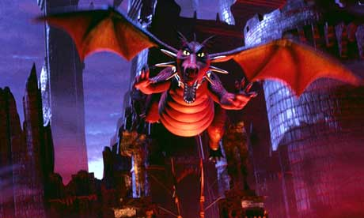
What Type(s) of Irony Am I? Interactive Q & A
Here’s where your laminated cards come into play. Red=verbal, blue=situational, green=dramatic.
Hold up the appropriate color(s) for the type of irony you feel is being portrayed in each of the following examples.
Be prepared to support your answers with reasoning: ie. what is the expectation versus the reality? In the case of dramatic irony, what do we know that the other characters don’t?
Ready? Our first example comes from Shrek!
Hold up your cards!
Who is correct?
What is your reasoning?

Slide 13
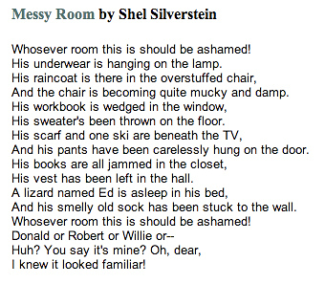
What Type(s) of Irony Am I? Interactive Q & A, Continued
Listen to an audio performance of Shel Silverstein’s “Messy Room”.
Put up your colors(s) as soon as you decide!

Slide 14
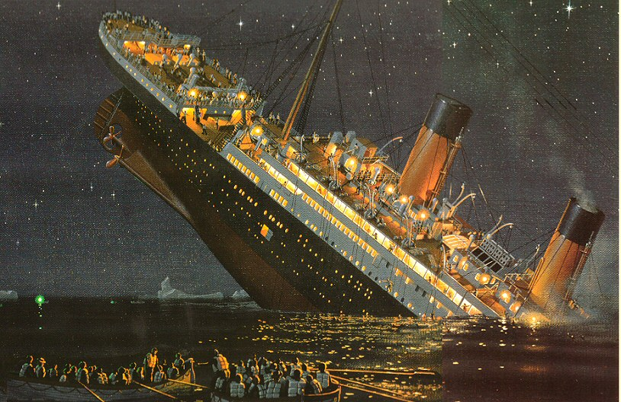
What Type(s) of Irony Am I? Interactive Q & A, Continued
“Titanic” boarding scene
Red, blue, or green?
Can you explain why?

Slide 15
What Type(s) of Irony Am I? Interactive Q & A, Final Example
Scene from Toy Story
Hold up your color(s) as soon as you have an idea during this 3 minute clip
What color(s) do we see the most?
Yes, this one clip involves ALL THREE TYPES of irony. But how?

