Slide 1
Tips For Writing
Well-Structured
Paragraphs
In Our Essays

Slide 2
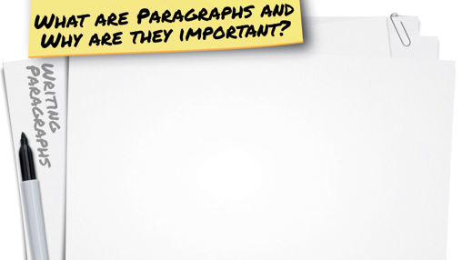
Without paragraphs, your writing would be one large block of text with no clear distinctions between ideas or thoughts.
Paragraphs give your writing structure, which makes it easier to read and understand. Structure allows you to be more articulate in putting your ideas on paper.

Slide 3
A good paragraph is all about STRUCTURE.
Body paragraphs should always contain the following:
Answer
Cite
Expand,
Elaborate, Explain
Conclude
Being mindful of this acronym will help you to write effective, thorough body paragraphs!

Slide 4
Let’s look at Answer
Each paragraph in an essay needs to deal with a single main idea or theme.
Oftentimes you will be prompted to write a paragraph (or an entire essay!) responding to a question. The first sentence needs to provide a clear Answer to that question.
This Answer is otherwise known as a Topic Sentence.

Slide 5
Let’s consider the following writing prompt:
In Guy de Maupassant’s short story, “The Necklace”, the main character, Madame Loisel, hides the truth when she loses her friend’s necklace. This causes many years of suffering as she and her husband work hard to repay the debt. The author’s claim would be that it is wiser to tell the truth and face the consequences, rather than hide a mistake.
Directions: Write a well-constructed paragraph analyzing how the author uses one or more of the following features listed below to support his claim that “honesty is the best policy”. Be sure that your analysis focuses on the most relevant features of the passage.
Your paragraph should not explain whether you agree or disagree with Guy de Maupassant, but rather explain how he uses literary devices to support his claim. You may use details, quotes from the passage, or paraphrase things to support your essay.
Character Motivation- (think about what motivates Madame Loisel to hide the truth)
Irony-(think about how situational irony impacts the overall theme)

Slide 6
How can I effectively answer the question?
First, we need to determine what, specifically, the prompt is asking.
My job is to explain how a literary element functions within the story to convey the author’s claim. Let’s go with character motivation.

Slide 7
Things to remember about the Answer portion of your paragraph (topic sentence):
The topic sentence should clearly present the main point of the paragraph.
After reading the topic sentence, your reader should have a solid understanding of what the paragraph will be about.
Your topic sentence should grab the reader’s attention and compel him or her to read on.

Slide 8
Now, on to Cite:
After stating your main point in your topic sentence, it’s up to you to find concrete evidence within the text to use as support. In most cases, you’ll be expected to offer a direct quotation from the text.
In order to seamlessly cite the text, it’s important to lead into the quote by signaling to the reader that it’s coming. Remember, it’s IMPERATIVE that you correctly parenthetically cite any direct quotations that you use.

Slide 9
Remember our topic sentence?
In Guy de Maupassant’s short story, “The Necklace,” Mathilde Loisel is too prideful to admit the truth to her friend, which results in disastrous consequences for both her and her husband.
Now, let’s cite the text to provide support!
After losing her friend’s diamond necklace at the ball, Mathilde and her husband panic, because they think they’ve lost an expensive treasure. M. Loisel hatches a deceitful plan in order to buy the couple some time to either find the necklace, or purchase a replacement. He says, “We’ll have to write your friend…to tell her you have broken the catch and are having it repaired. That will give us a little time to turn around” (230).

Slide 10
Things to remember about Cite:
In order to provide compelling support for your topic sentence, you must include a direct quote from the source.
Choose your support wisely. The stronger the quote, the stronger your overall paragraph will turn out.
All direct quotations must be correctly parenthetically cited within the body of the paragraph.

Slide 11
Let’s Look at Expand, Elaborate, and Explain
Now that you’ve offered your Answer and Cited the text to support it, your job is to Expand, Elaborate, and Explain how the quote you’ve chosen proves the point you’re trying to make.
This is perhaps the most important element of the paragraph, therefore it should be the longest. One sentence WILL NOT CUT IT.
Here, you reveal your understanding of the question being asked.

Slide 12
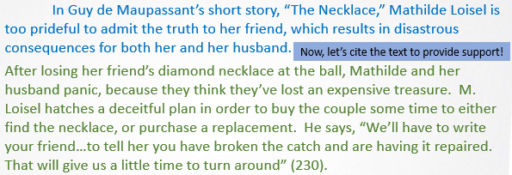
Back to Our Rough Draft:
Now, let’s explain ourselves.
De Maupassant offers a situation here where the character is motivated to lie to her friend, because it’s important for her to save face. She doesn’t want to admit that she was careless with the necklace that she borrowed. However, had she been honest from the start, it could have saved her ten long years of working to repay the debt accumulated from buying a replacement necklace. Honesty would have clearly been the best policy in this case, because Mme. Loisel would have known that the necklace was, in fact, fake. Her own pride, though, stood in the way.

Slide 13
Things to remember about Expand, Elaborate, and Explain
In order to do a thorough and effective job, you must provide a detailed Explanation, Expansion, and Elaboration.
This will show your reader that you understand the question you’ve been asked, and will give substance to your essay.
This section should represent the majority of your paragraph.

Slide 14
Let’s look at Conclude
Finally, after you’ve made your main point by Answering the question, Cited textual evidence to support it, and offered a detailed Explanation of the evidence, you need a Concluding sentence which links the point being made back to the main essay topic.

Slide 15
Back to Our Rough Draft:
Time to wrap things up.
Character motivation provides the means by which the main character learns that being dishonest is never a good idea. Rather, it is revealed to her that telling the truth could have prevented her from living the life of the poor only to find out in the end that it was entirely unnecessary.

Slide 16
Each of your paragraphs should contain the following:
Answer
Cite
Expand, Elaborate, Explain
Conclude
Here’s where you present a topic sentence, answering the prompt being asked of you.
Cite the text to provide concrete support for your topic sentence.
The bulk of your paragraph, here’s where you prove you understand the prompt by explaining how the citation proves the topic sentence.
Finally, wrap it up by offering a conclusion sentence that links the paragraph back to the wider topic.

Slide 17
Consider the following paragraph.
School uniforms can have an extremely positive effect on the social dynamics in a school. One study in Florida found that school uniforms “eliminated status barriers, which made it easier for peers to work collaboratively” (Collins 84). Uniforms can make students less competitive. They reduce the need for students to compete with each other through their choice of clothing. Uniforms can create equality amongst students. School uniforms help create a school identity. Uniforms make students feel a sense of pride towards their school. It would be sensible for schools to review their school uniform policies.
We can see that the ACEC elements are all there, but doesn’t the overall fluency feel stilted and disconnected?

Slide 18
Now, look at it with a few changes.
School uniforms can have an extremely positive effect on the social dynamics in a school. One study in Florida found that school uniforms “eliminated status barriers, which made it easier for peers to work collaboratively” (Collins 84). One of the main benefits of this is the fact that uniforms can make students less competitive, as they reduce the need for students to compete with each other through their choice of clothing. Moreover, uniforms can create equality amongst students. Similarly, school uniforms help create a school identity, because they make students feel a sense of pride towards their school. Therefore, it is clear that it would be sensible for schools to review their school uniform policies.

Slide 20
Follow the ACEC method.
Stick to one topic per paragraph.
Link your sentences with transitional words and phrases.

